Slide 1
Data Science Bowl 2018
Data Quality Issues

Slide 2
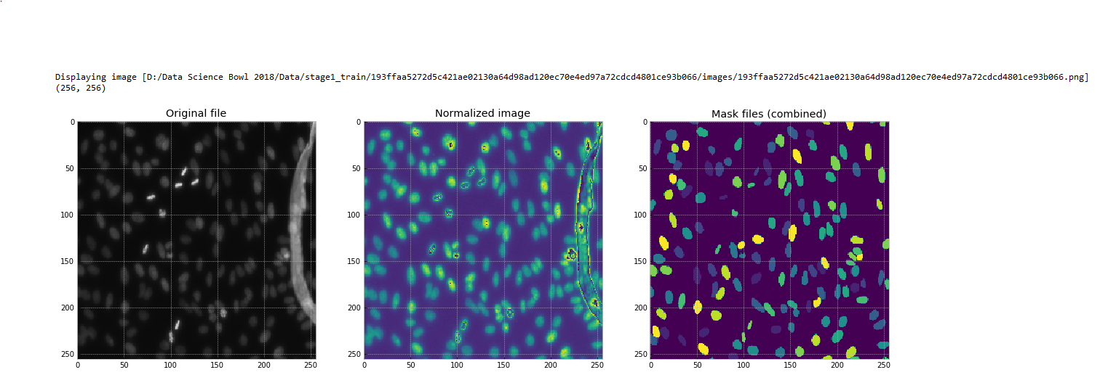
Obfuscation of Nuclei (Debris)

Slide 3
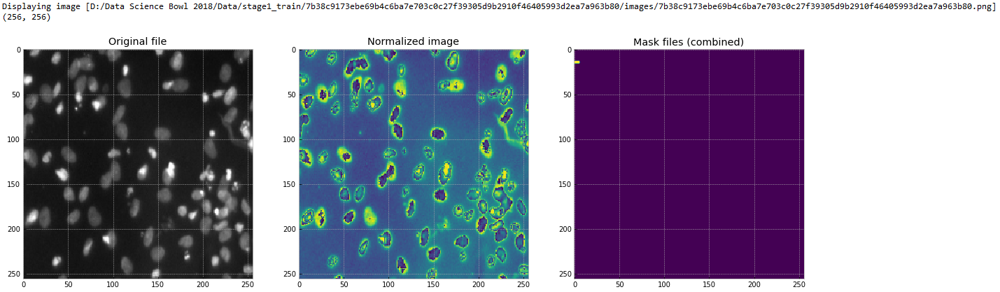
Missing Masks (Total)

Slide 4
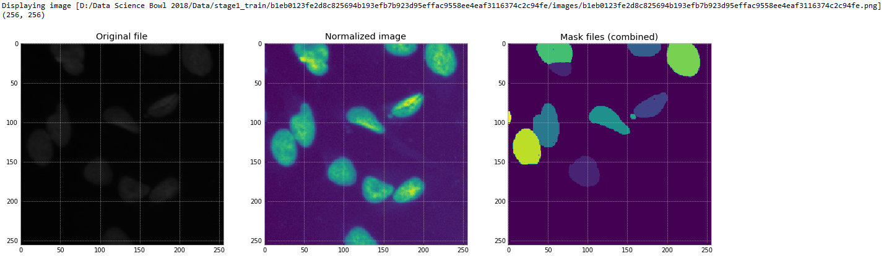
Missing Masks (Partial)

Slide 5
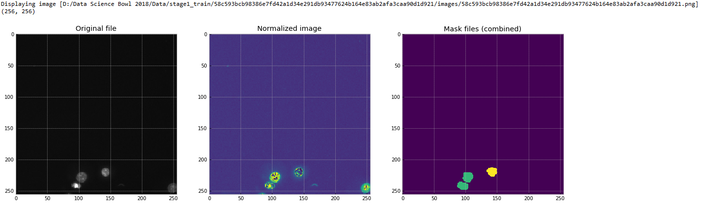
Missing Masks (Partial)

Slide 6
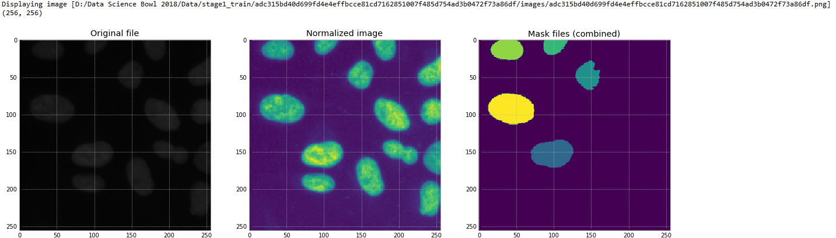
Missing Masks (Partial)

Slide 7
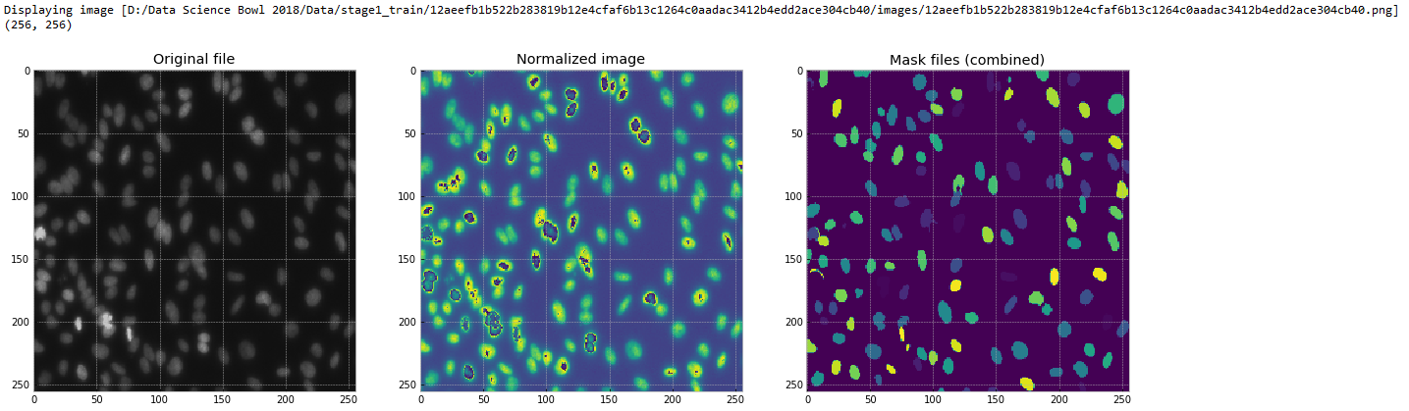
Noisy & Missing Masks (Poorly Annotated)

Slide 8
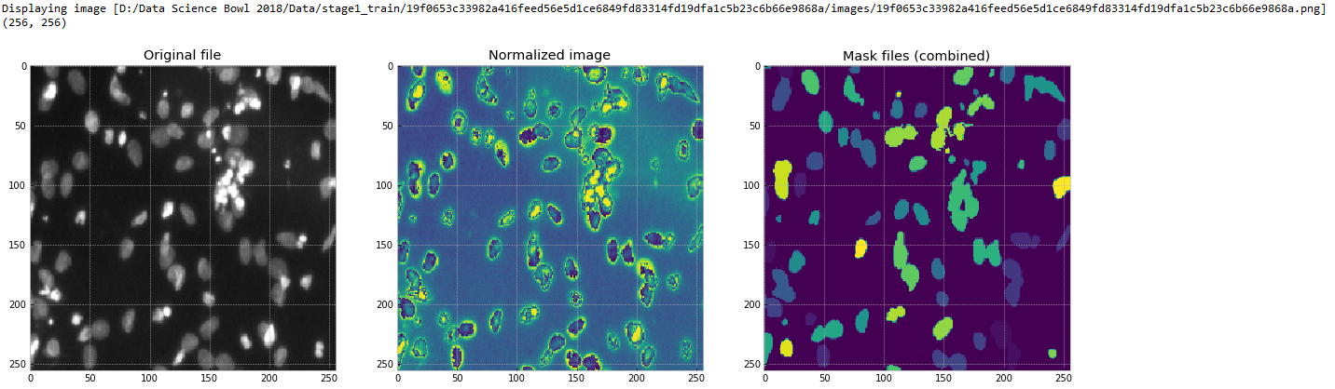
Inappropriate Blending

Slide 9
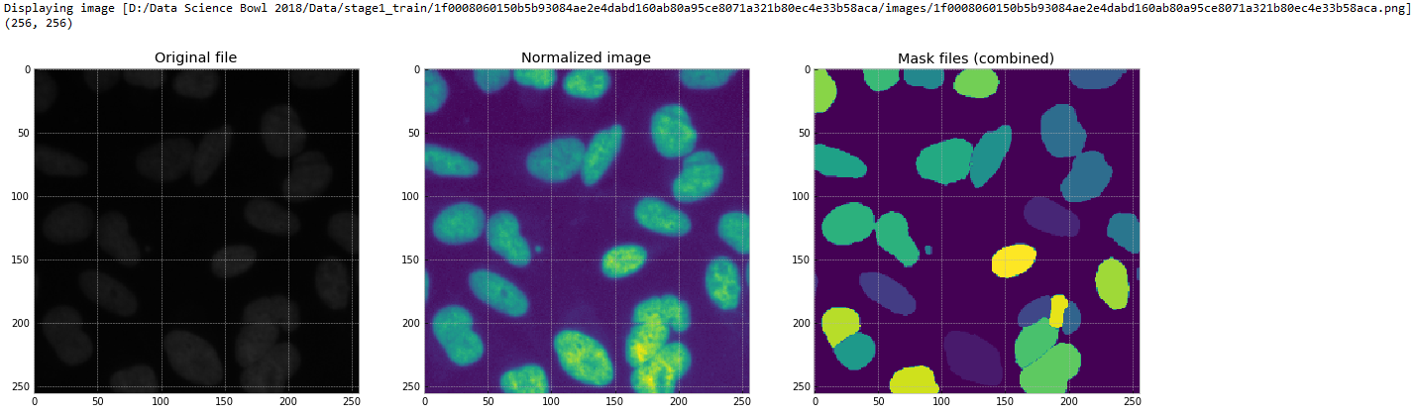
Inappropriate Blending (Contd)

Slide 10
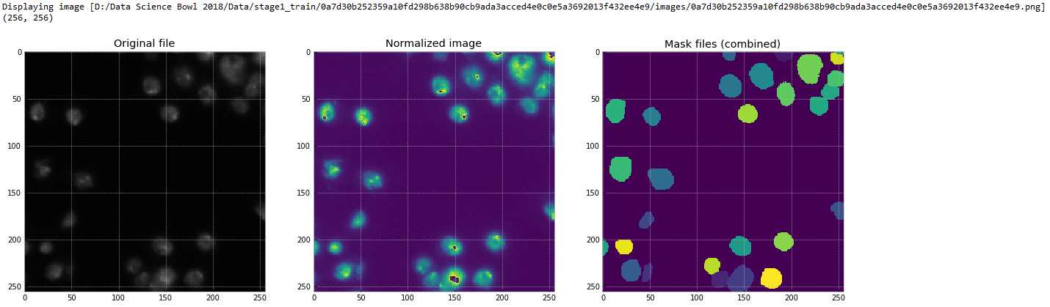
Inappropriate Blending (Contd)

Slide 11
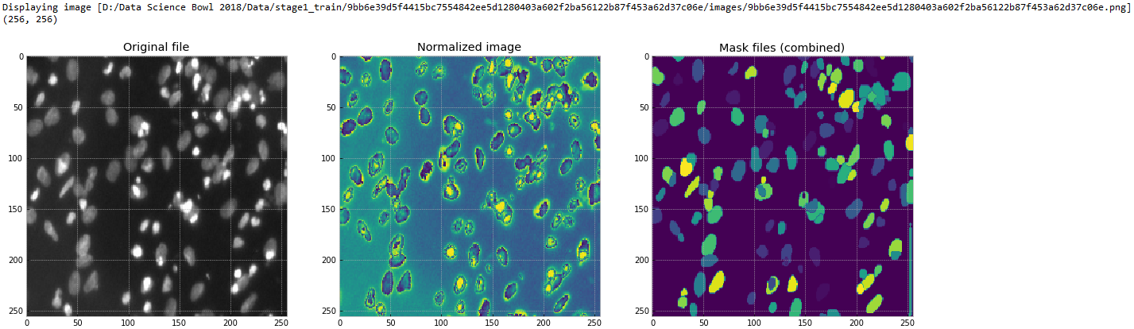
False Positives

Slide 12
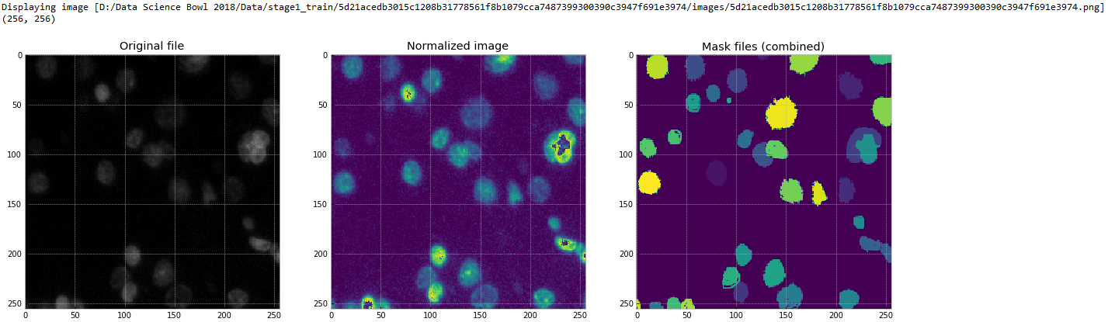
Pinholes in Masks

Slide 13
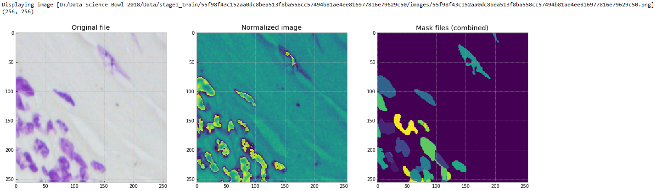

Pixel Noise & Blending

Slide 14
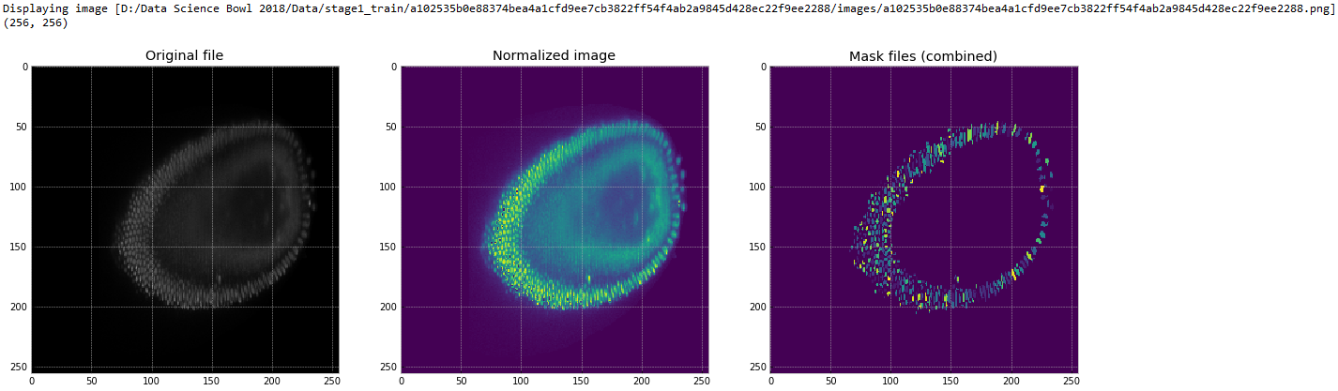
Beautiful… but dissimilar!
NOTE: Drosophila embryo; nuclei surround the edge of embryo before division.

Slide 15
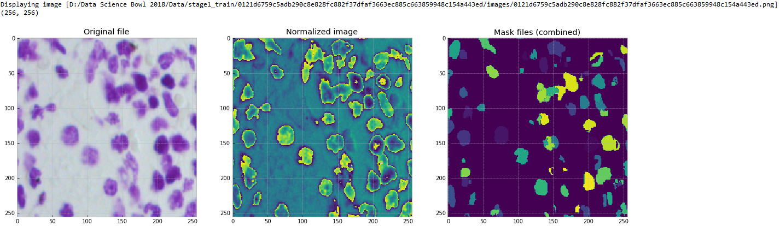
Multiple Mistakes
overlapping masks (violation of rules)
not a nucleus
only one nucleus
(probably)

Slide 16
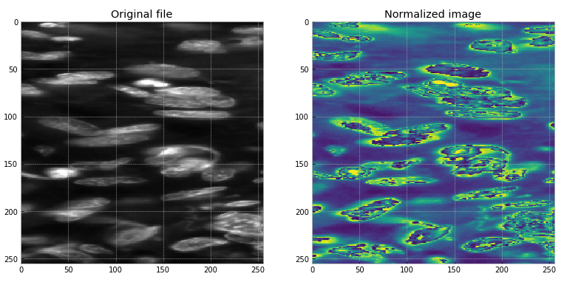
Tricky Problems (Apoptosis)
apoptotic bodies; blebbing and possible karyorrhexis (fragmentation).

Slide 17
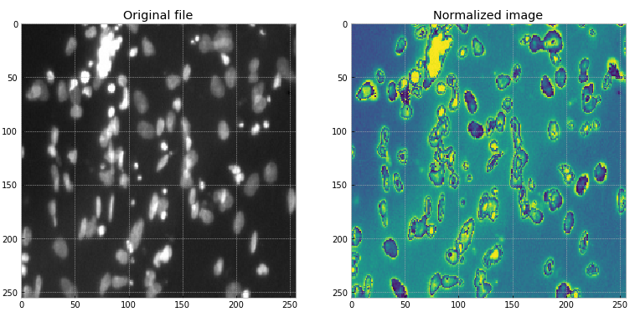
Tricky Problems (Overexposure)

Slide 18
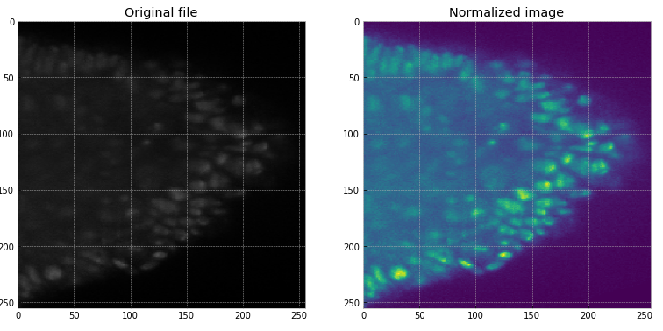
Tricky Problems (Low-Quality Imaging)

